Slide 1
What Is a Satellite?

Slide 2
Table of contents
01
02
03
04
Let’s learn about satellites
Types
of satellites
The most important satellite
Fun facts about space

Slide 3
To start with…
What is a satellite?
Satellites are objects, either natural or artificial, that circle (orbit) around a planet

Slide 4
01
Let’s learn about satellites

Slide 5
Why are satellites important?
Satellites allow us to explore space, to observe the Earth from different angles, and to obtain data that help scientists to carry out different research on space
With the progress of technology and science, satellites were found to be able to improve telecommunications, because they allow the correct functioning of the most used means of communication: television, cell phones, internet, etc.

Slide 6
02
Types of satellites

Slide 7
Natural satellites
Natural satellites are those celestial bodies that are part of the solar system, such as…
The Moon
The Moon is Earth's satellite as it orbits the Earth. Natural satellites are usually smaller than the celestial body they orbit

Slide 8
Artificial satellites
Artificial satellites are objects composed of a power source and an antenna, which are created by humans to orbit a celestial body in order to provide different types of information. Satellites are launched into space by rocket

Slide 9
What is the purpose of an artificial satellite orbiting the Earth?
These satellites are important because they...
provide information about the planet
observe meteorological changes
contribute to human and social development
promote telecommunications
serve as a power source for solar energy

Slide 10
03
The most important satellite

Slide 11
The Moon
The Moon is the most recognized natural satellite as it orbits around the Earth
The distance of the Moon from the Earth is 384,400 km. Although it may seem far away, it is one of the closest satellites to the Earth
More than 24,000 objects (both natural and artificial) that orbited the Earth have been recorded throughout history

Slide 12
Fun facts
about space
04

Slide 13
The first artificial satellite
1957
1958
Sputnik 1
The first satellite called Sputnik 1 was sent into space by the Soviet Union in 1957 in order to obtain information about space and the layers of the atmosphere
Explorer 1
The following year, the United States sent its first satellite, Explorer 1, which led to the discovery of the Van Allen belts

Slide 14
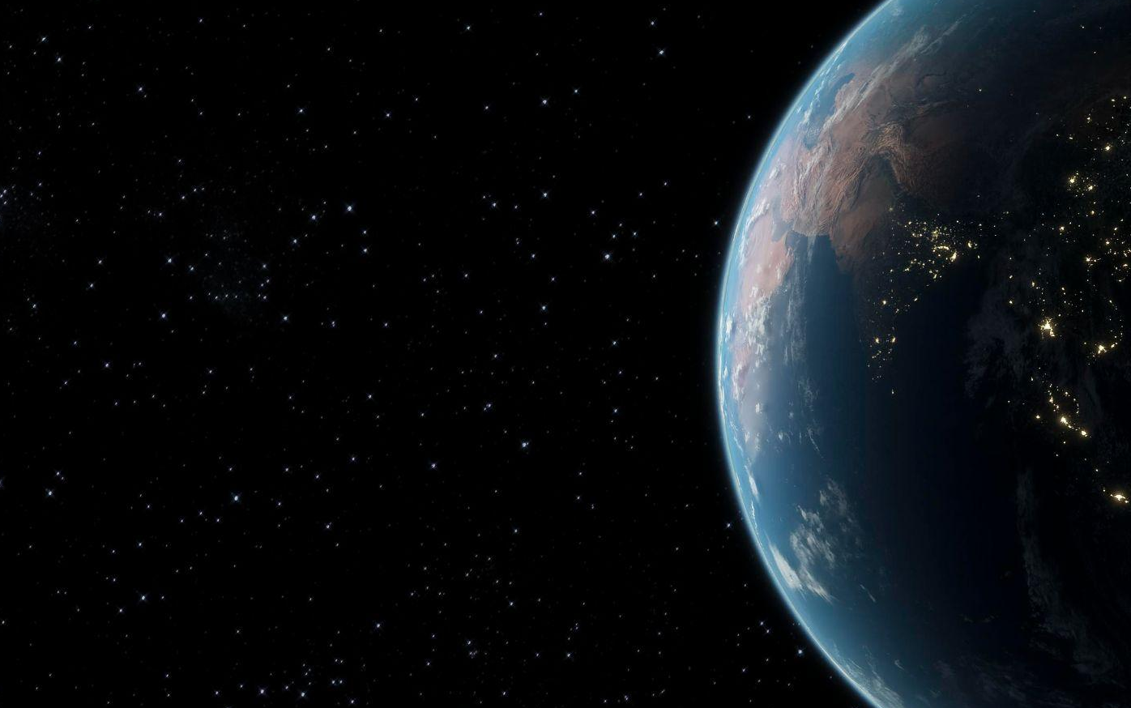
The first photo of the Earth
The satellite called Explorer 6, launched in the United States by NASA in 1959, was the first satellite to take a picture of the Earth. A great event for the world since no one had ever observed the Earth from space

Slide 15
Which country has launched most satellites into space?
The country that has launched the most satellites into space is the one that sent the first one: Russia has 1420 satellites. This is followed by the United States, which sent the second satellite, with 1049 satellites. This is followed by Japan with 107, China with 98 and France with 42 satellites.
 | Russia | 1420
 | United States | 1049
 | Japan | 107
 | China | 98
 | France | 42

Slide 16
Thanks
Do you have any questions?
youremail@freepik.com
+91 620 421 838
yourwebsite.com
Please keep this slide for attribution

Slide 17
Alternative resources
Here’s an assortment of alternative resources whose style fits the one of this template:
Vectors
Outer space

Slide 18
Resources
Did you like the resources in this template? Get them for free at our other websites:
Vectors
Outer space
Groups of football world championship with different flags
Modern pack of american flags
Photos
Galaxy night landscape

Slide 19
Instructions for use
If you have a free account, in order to use this template, you must credit Slidesgo by keeping the Thanks slide. Please refer to the next slide to read the instructions for premium users.
As a Free user, you are allowed to:
Modify this template.
Use it for both personal and commercial projects.
You are not allowed to:
Sublicense, sell or rent any of Slidesgo Content (or a modified version of Slidesgo Content).
Distribute Slidesgo Content unless it has been expressly authorized by Slidesgo.
Include Slidesgo Content in an online or offline database or file.
Offer Slidesgo templates (or modified versions of Slidesgo templates) for download.
Acquire the copyright of Slidesgo Content.
For more information about editing slides, please read our FAQs or visit our blog:
https://slidesgo.com/faqs and https://slidesgo.com/slidesgo-school

Slide 20
Instructions for use (premium users)
As a Premium user, you can use this template without attributing Slidesgo or keeping the Thanks slide.
You are allowed to:
Modify this template.
Use it for both personal and commercial purposes.
Hide or delete the “Thanks” slide and the mention to Slidesgo in the credits.
Share this template in an editable format with people who are not part of your team.
You are not allowed to:
Sublicense, sell or rent this Slidesgo Template (or a modified version of this Slidesgo Template).
Distribute this Slidesgo Template (or a modified version of this Slidesgo Template) or include it in a database or in any other product or service that offers downloadable images, icons or presentations that may be subject to distribution or resale.
Use any of the elements that are part of this Slidesgo Template in an isolated and separated way from this Template.
Register any of the elements that are part of this template as a trademark or logo, or register it as a work in an intellectual property registry or similar.
For more information about editing slides, please read our FAQs or visit our blog:
https://slidesgo.com/faqs and https://slidesgo.com/slidesgo-school

Slide 21
Fonts & colors used
This presentation has been made using the following fonts:
Secular One
(https://fonts.google.com/specimen/Secular+One)
Heebo
(https://fonts.google.com/specimen/Heebo)
#f3f3f3
#302c27
#666666
#999999
#1bcdff
#1a8db5
#f1c232
#e90923
#fa8156
#00a388

Slide 22





Storyset
Create your Story with our illustrated concepts. Choose the style you like the most, edit its colors, pick the background and layers you want to show and bring them to life with the animator panel! It will boost your presentation. Check out how it works.
Pana
Amico
Bro
Rafiki
Cuate

Slide 23
Use our editable graphic resources...
You can easily resize these resources without losing quality. To change the color, just ungroup the resource and click on the object you want to change. Then, click on the paint bucket and select the color you want. Group the resource again when you’re done. You can also look for more infographics on Slidesgo.

Slide 26
JANUARY
FEBRUARY
MARCH
APRIL
MAY
JUNE
PHASE 1
Task 1
Task 2
PHASE 2
Task 1
Task 2
JANUARY
FEBRUARY
MARCH
APRIL
PHASE 1
Task 1
Task 2

Slide 29


